Slide 1
COmmand Design Pattern
Brett Recker
Radwan Albadawi

Slide 2
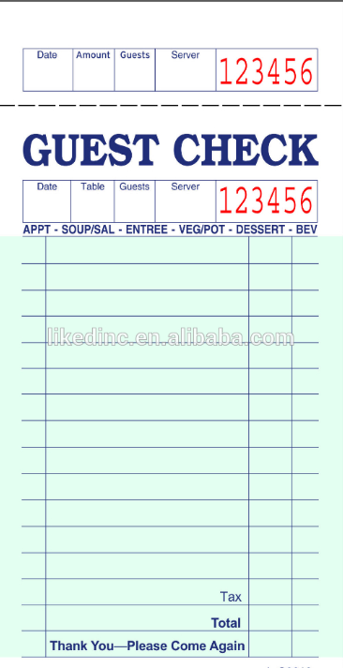
Story
Encapsulate a request as an object letting you parametrize clients with different requests, queue or log requests, and support undoable operations.
Promote "invocation of a method on an object" to full object status
An object-oriented callback
Notes:
The check/order at a restaurant is a good example of this. The waiter/waitress takes an order command from the customer and encapsulates it by writing it on the check. It is then queued to the cook for instructions on what food to make.
The check is not dependent on the menu so it can support commands to cook any food items.

Slide 3
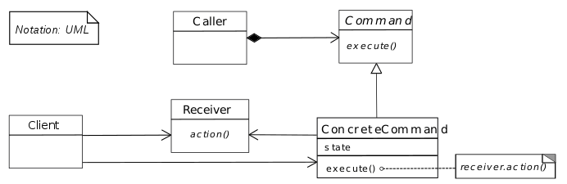
UML Design
Notes:
Command declares an interface for all commands, providing a simple execute() method which asks the Receiver of the command to carry out an operation. The Receiver has the knowledge of what to do to carry out the request. The Caller holds a command and can get the Command to execute a request by calling the execute method. The Client creates ConcreteCommands and sets a Receiver for the command. The ConcreteCommand defines a binding between the action and the receiver. When the Caller calls execute the ConcreteCommand will run one or more actions on the Receiver.

Slide 4

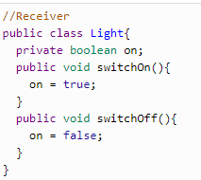
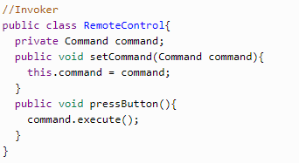
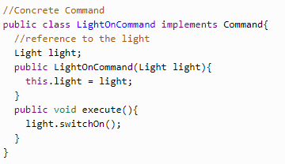
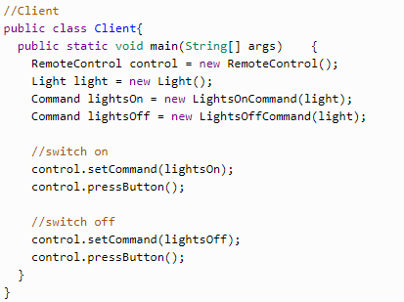
Code
Notes:
First, we have our command interface which holds all commands.
Next, the concretecommand class LightsOnCommand, extends command in this case to turn lights on and off.
Then our receiver class contains the logic to carry out the command.
Our Invoker, or caller, in this case is a remote control which gets the command to execute by calling the execute method.
Lastly, the client class is set up to use the caller class to invoke the command.

Slide 5
Quiz
In the command pattern, are requests encapsulated as objects?
Is the command created and executed by the same class?
What is the role of the receiver?
Notes:
Yes, this allows clients to be parametrized with different requests
No, commands are created by one client that knows what need to be done (client), and passed to another client that has the resources for doing it (receiver).
Accepts the request and performs a specific action on it.

Slide 6
Sources
https://sourcemaking.com/design_patterns/command
https://www.oodesign.com/command-pattern.html
https://dzone.com/articles/design-patterns-command

